Slide 1
From Borders to Boardrooms: Advancing Women, Trade and Inclusion
Innocent Kawooya, NIM, Charlotte Neeza, Doreen Nanfuka, Nicholas Kalungi, Joseph Kimbowa, Dr. Jonathan Pinfolo – COO, DFI

Slide 2
Introduction
Focus: Advancing women, trade, and inclusion across Africa.
Framework: Inclusive Instant Payment Systems (IIPS) as catalysts for dignity, health, wealth, and opportunity.
Theme: From borders to boardrooms – where technology meets humanity.
Broadcast URL: https://www.youtube.com/watch?v=hhQcOxwt3mc

Slide 3
Innocent Kawooya, NIM – CEO, HiPipo
Talking Point: IIPS is the last-mile hook for financial inclusion, where technology meets dignity, health, wealth, and opportunity.
Discussion Highlights:
Dignity belongs at the center of financial inclusion.
Policy must embed IIPS into national frameworks.
The future of inclusive payments in Africa.
Quote: “When we talk about IIPS, we must see beyond the pipes and platforms. It is the moment where technology becomes dignity for a mother trader.”

Slide 4
Innocent Kawooya – Key Insights
IIPS = Last-mile hook for inclusion.
Inclusion = Dignity, not just access.
HiPipo’s Include Everyone Program empowers FinTechs, women, and traders.
Policy integration is essential for scaling trust and adoption.
Vision: Human systems, not just digital systems.

Slide 5
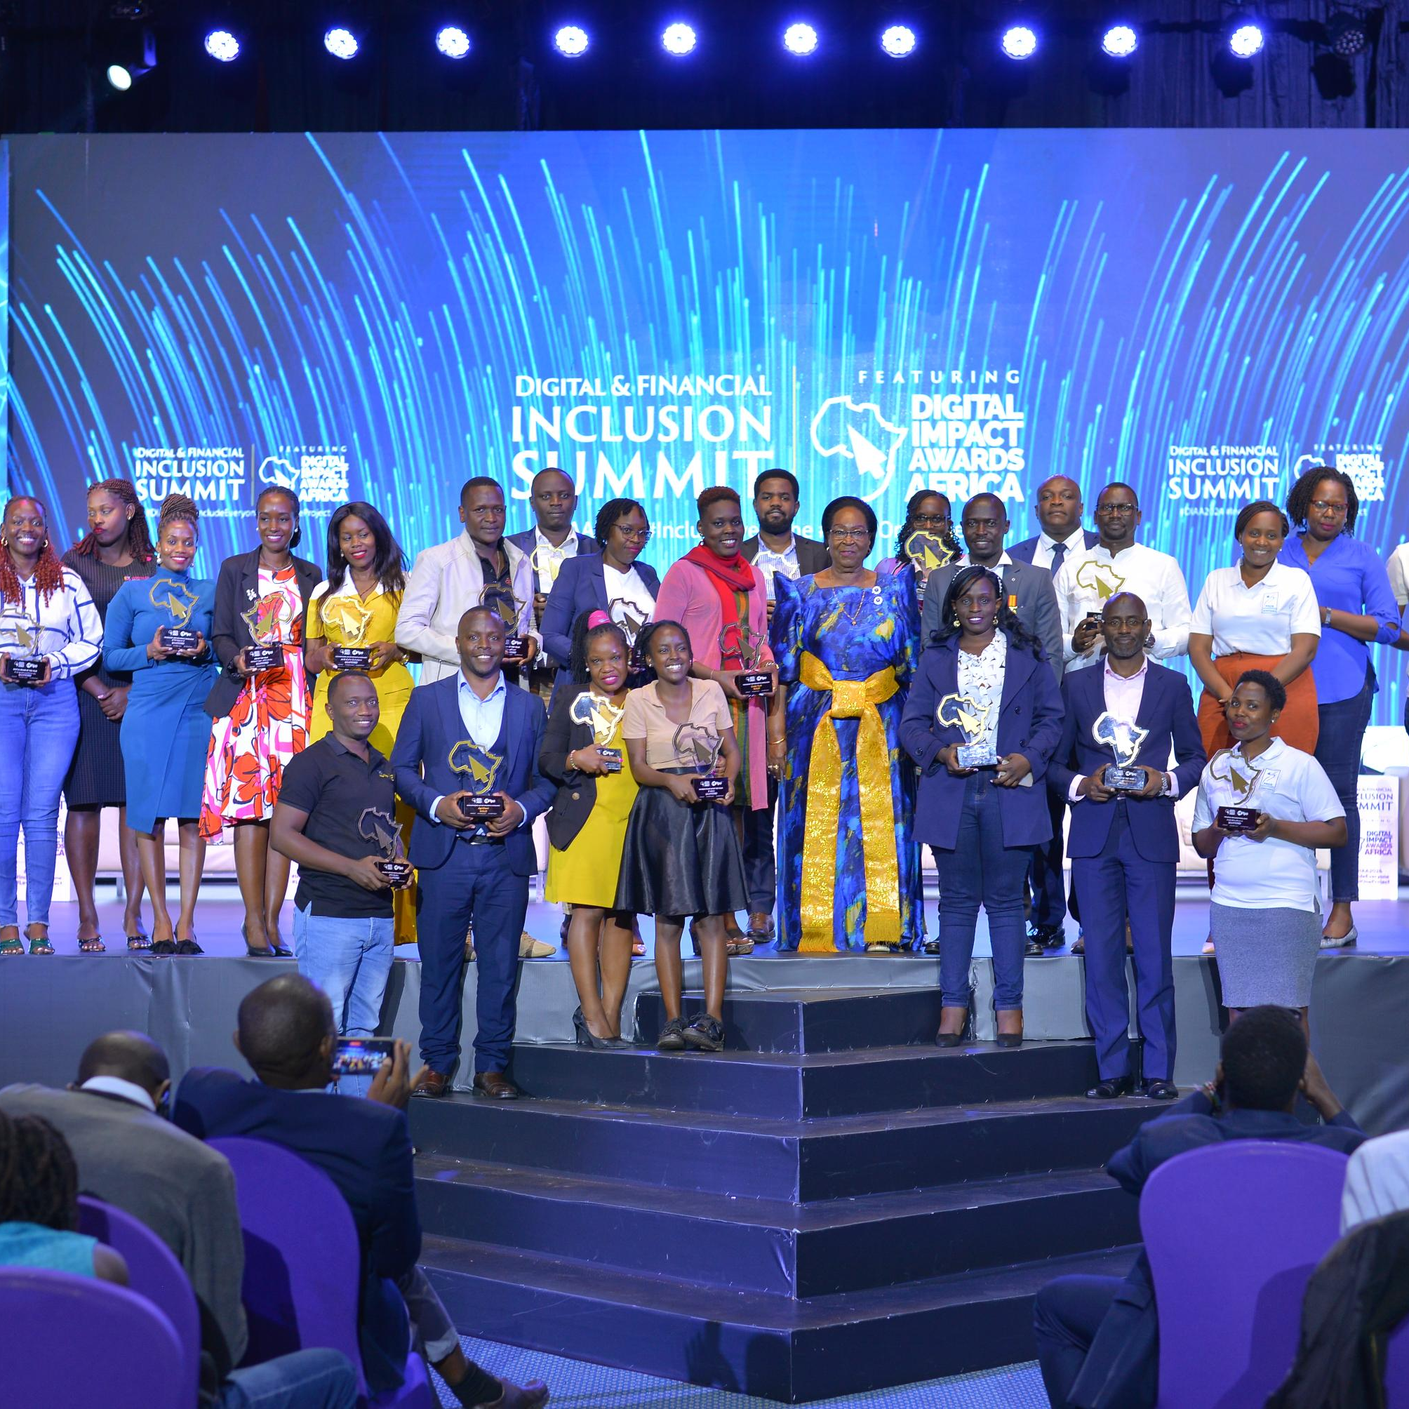
Nicholas Kalungi – COO, HiPipo (Strategic & Policy Anchor)
Talking Point: For IIPS to succeed, they must be embedded into national and regional frameworks.
Discussion Highlights:
Policy determines whether financial innovations succeed or remain pilots.
Integration of IIPS into COMESA frameworks.
Readiness of FinTechs and traders is vital for sustainability.
Quote: “Policy, infrastructure, and community preparedness must work hand-in-hand. That is the only way to sustain adoption.”

Slide 6
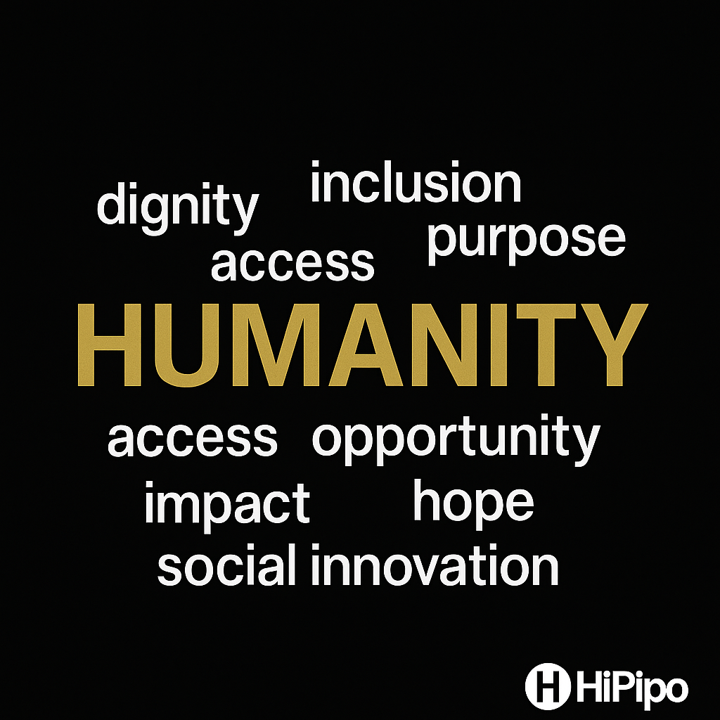
Nicholas Kalungi – Key Insights
IIPS success = policy + market readiness.
COMESA as a testbed for regional integration.
Collaboration with CBC, central banks, and mobile network operators.
Proof that inclusion and policy must align to create real economic transformation.

Slide 7
Charlotte Neeza – FinTech Events Manager, HiPipo (Community & Ecosystem Voice)
Talking Point: Visibility builds trust and accelerates adoption for innovators and users.
Discussion Highlights:
Visibility drives trust and adoption.
40 Days 40 FinTechs generated 2.6B impressions globally.
Inclusion through storytelling and visibility.
Quote: “Inclusion means women innovators and traders see themselves in the digital economy, as leaders shaping its future.”

Slide 8
Charlotte Neeza – Key Insights
Visibility is the bridge between innovation and trust.
Storytelling helps regulators and investors connect with FinTechs.
40 Days 40 FinTechs as a model for ecosystem building.
Inclusion through representation and leadership visibility.

Slide 9
Joseph Kimbowa – Chief Content Officer, HiPipo (Impact & Evidence Anchor)
Talking Point: Evidence proves that equipped innovators design for the underserved.
Discussion Highlights:
68% of FinTechs developed gender-intentional products.
88% found the program relevant to growth.
More than half now target women, youth, and SMEs.
Quote: “When innovators build for inclusion, they create real demand for IIPS to thrive and scale.”

Slide 10
Joseph Kimbowa – Key Insights
Evidence-driven advocacy shapes policy and funding.
Inclusion-focused innovators drive organic adoption.
Visibility and trust close the gap between innovation and usage.
HiPipo bridges innovation and human impact.

Slide 11
Dr. Jonathan Pinfolo – COO, DFI (Regional/Global Connector)
Talking Point: Market readiness is the key to IIPS adoption; technology alone is not enough.
Discussion Highlights:
DRPP links national payment switches into one interoperable network.
COMESA–HiPipo partnership: infrastructure + empowerment.
Blueprint for Africa: from borders to boardrooms.
Quote: “While we build the rails, HiPipo builds the confidence, skills, and trust that ensure adoption.”

Slide 12
Dr. Jonathan Pinfolo – Key Insights
DRPP as the backbone of regional financial integration.
Technology must meet market readiness.
Empowerment of women, FinTechs, and traders drives adoption.
The partnership model = blueprint for Africa.

Slide 13
Doreen Nanfuka – Senior Programs Officer, HiPipo
Talking Point: Building confidence, trust, and identity is essential for adoption.
Discussion Highlights:
Major barriers: trust, access, and identification.
Need for simplified KYB/KYC processes.
Embedding IIPS into national frameworks.
Women and traders must see themselves in the digital economy.
Quote: “To drive adoption, we must build confidence, not just systems.”

Slide 14
Closing Unifier – All Speakers
Unified Message: “HiPipo’s role is proving that IIPS are not just technology, they are human systems. By preparing FinTechs, empowering women, and building trust in DFS, we create the demand, capacity, and leadership needed to make inclusive instant payments the norm across Africa.”
Theme: From Borders to Boardrooms – Inclusion is Africa’s foundation for resilience and growth.

